Slide 1
“Emergency response techniques by measuring heart rate and blood pressure via Smartphone application”
Presented by:
Vimal Jaswal - B00122875
MIOT - H6022
Technological University Dublin
Blanchardstown
Supervised by:
Dr. Brian Debrit

Slide 2
Introduction and Background
Heart disease and Blood Pressure is a common issue that causes hypertension as well. COVID-19 pandemamic also impacted the health services for these diseases[1]
The improvement of health and wellbeing progressively depend on remote Smartphone applications and organized sensors and actuators. [2]
Research Question
"How can we improve emergency medical services by determining medical parameters like blood pressure and pulse rate via Smartphone application?"

Slide 3
Problem Statement &objectives
The unavailability of medical service or support when required could result in panic or mental stress to the patient which further increases the problem
Objectives
To develop a user friendly and efficient Smartphone application to connect patients with doctors.
To understand the role of Smartphone application to measure heart rate or blood pressure parameters and reduce response time of medical professionals and emergency services.

Slide 4
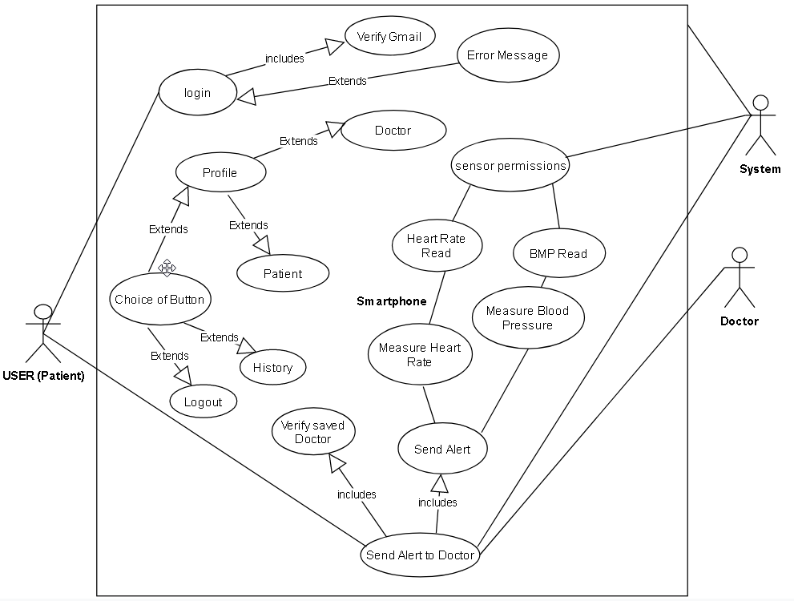
UML Diagram for Smartphone application

Slide 5
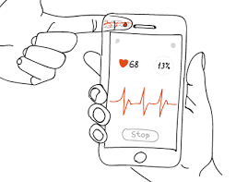
Photoplethysmography for Smartphone Application
By using the white light-emitting diode as light source and the phone camera as Photo detector, a Smartphone could be used to perform photoplethysmography (PPG).
The User acts as an actuator and Smartphone can be served as sensor to measure the volume of blood pressure and oscillations. A tissue sample is illuminated and collected as light absorption due to pulsating blood volume within tissue.

Slide 6



Application Development Requirements
A computer system with minimum 4 gigabytes of RAM, 250 gigabytes storage, windows 10 operating system
Android studio software installed
Java application package installed
Google firebase account for data storage
Internet Connectivity

Slide 7
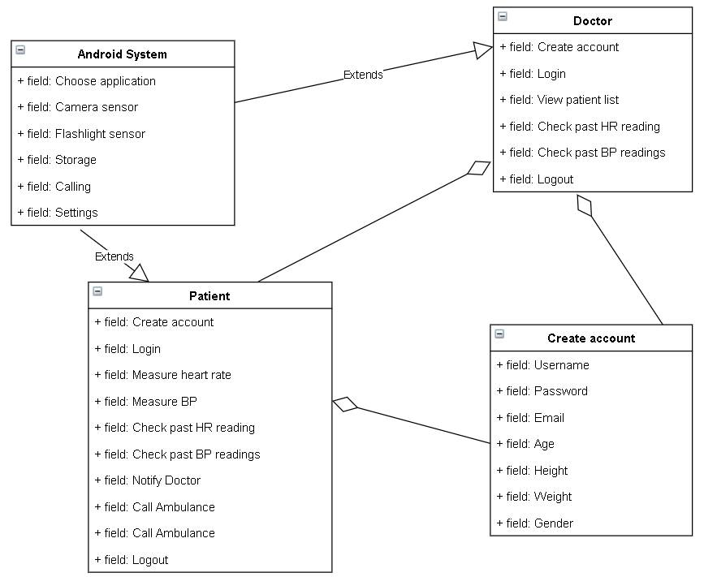
Class Diagram for Application

Slide 8
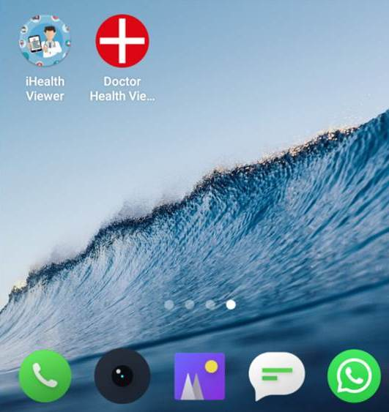
Testing and Implementation
To validate the application files can be installed into the android device successfully without interruption

Slide 9
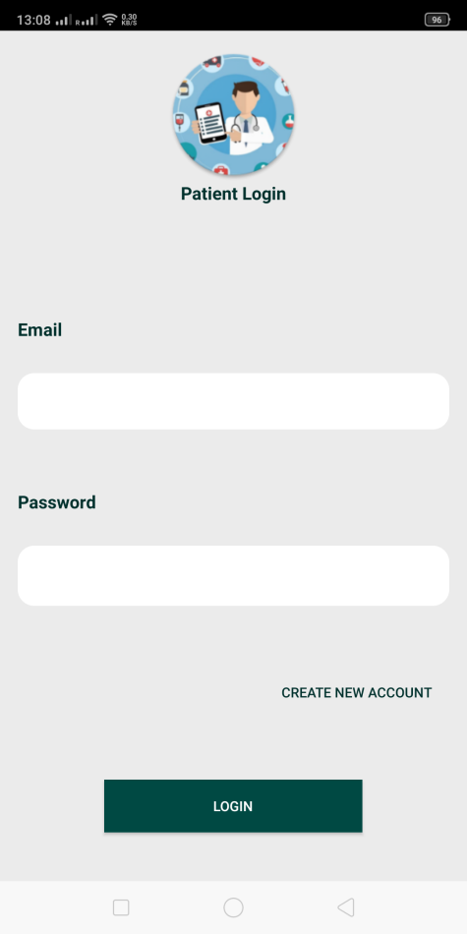
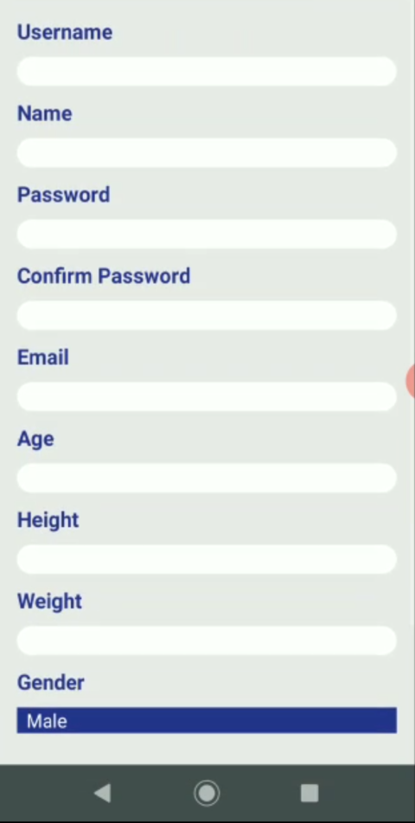
Testing and Implementation
To verify that the patient is able to create new account by entering data in all mandatory fields and is able to successfully login.

Slide 10
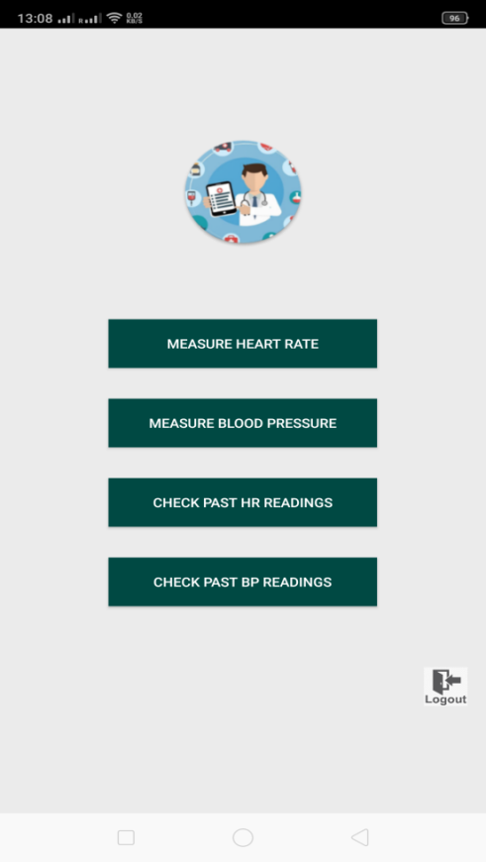
Testing and Implementation
To verify the patient is able to login to the primary page of patient where all the fields related to measurement and history data is working properly.

Slide 11
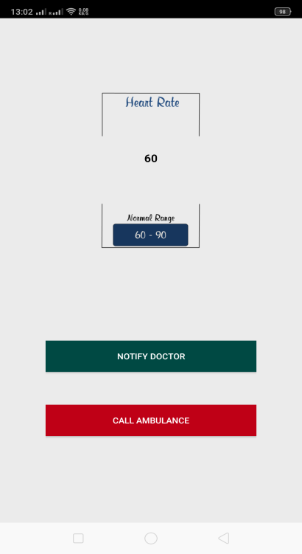
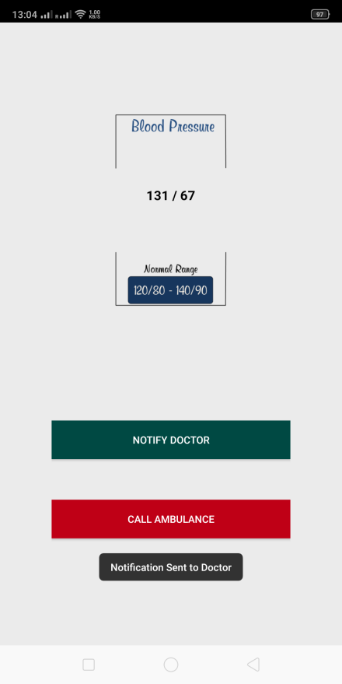
Testing and Implementation
To verify the patient is able to take heart rate and blood pressure readings successfully without interruption.

Slide 12
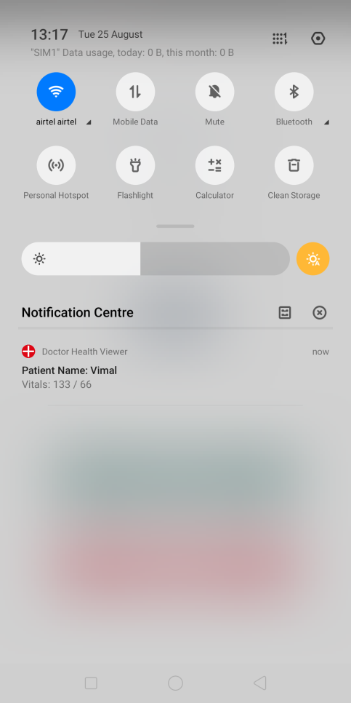
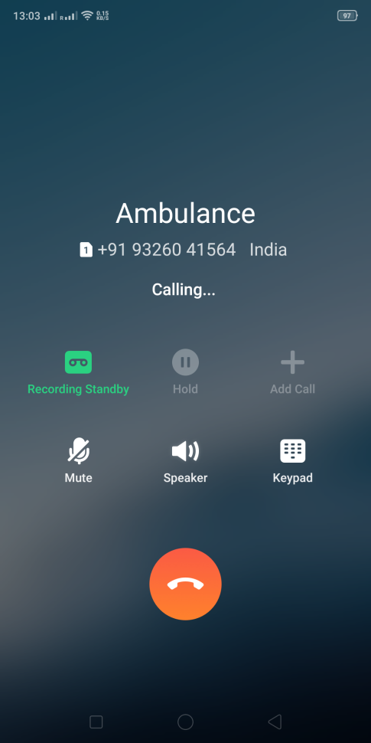
Testing and Implementation
To validate the user is able to see the results of heart rate and blood pressure measurement and able to send notification to doctor or call ambulance successfully.

Slide 13
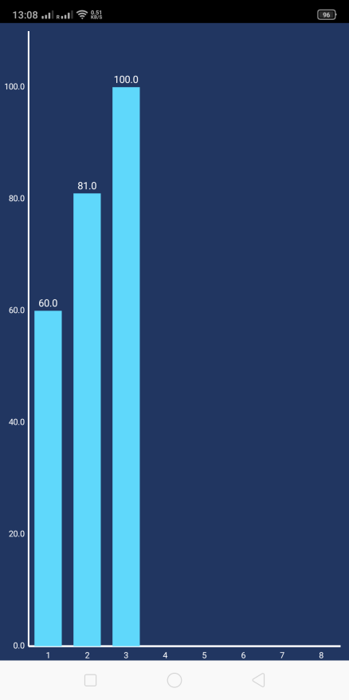
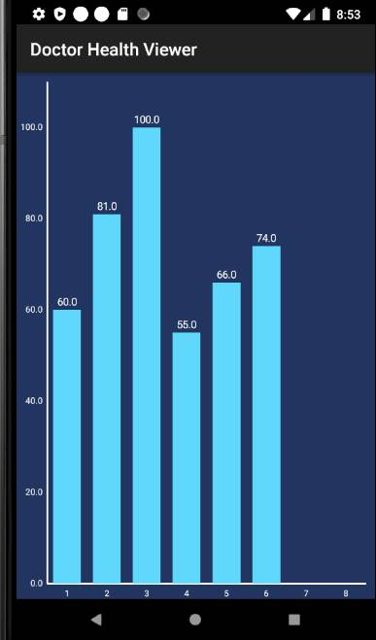
Testing and Implementation
To validate patient is able to record heart rate and blood pressure as per requirement and able to see history graphs for each parameter separately.

Slide 14
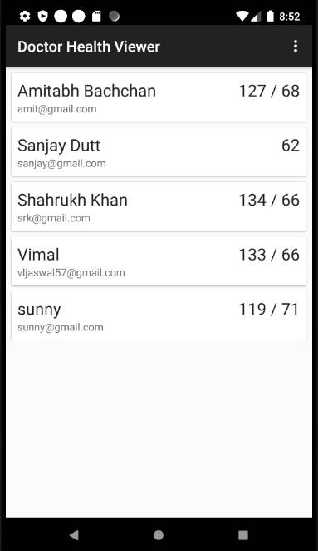
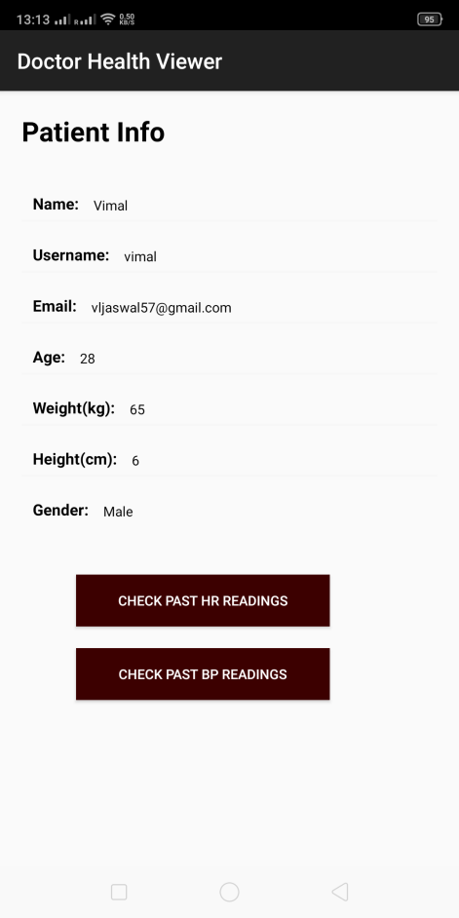
Testing and Implementation
To verify that doctor receives notification from patient successfully with all the details and readings. To validate all the buttons and textboxes works correctly for user without any error.

Slide 15
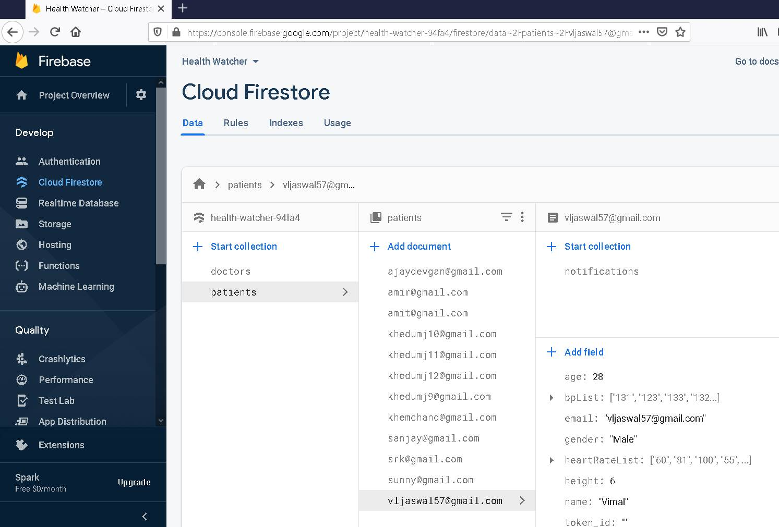
Firebase Database View

Slide 16
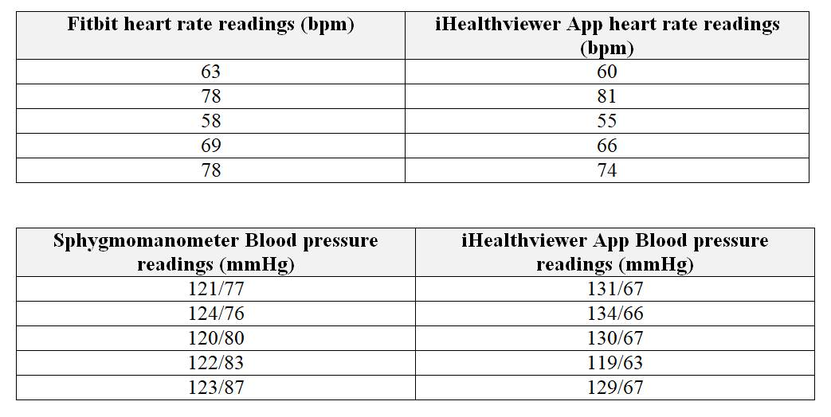
Comparison of Application Readings

Slide 17
Conclusion and Future Work
Smartphone based measurement of parameters such as heart rate and blood pressure can improve the emergency and medical services.
There are several functionalities that can be added such as prescriptions, location, medical conditions of the patient, booking appointments etc.
Measurement of body temperature by infra red could also be taken into consideration for additional development.
This research could be helpful in understanding various functionalities of Smartphone for future medical service applications.
Data collected by application can be utilised for further data analysis.

Slide 18
References
[1] Who.int. 2020. COVID-19 Significantly Impacts Health Services For Noncommunicable Diseases. [online] Available at: <https://www.who.int/news-room/detail/01-06-2020-covid-19-significantly-impacts-health-services-for-noncommunicable-diseases> [Accessed 19 June 2020].
[2] Higgins, J.P., 2016. Smartphone applications for patients' health and fitness. The American journal of medicine, 129(1), pp.11-19.

Slide 19
Thank You…

